Slide 1
CAPSTONE PROJECT
Presented By:
SIVABHARATHI S
THANTHAI PERIYAR GOVT INSTITUTE OF TECHNOLOGY VELLORE
CIVIL ENGINEERING
Credit Card Default Prediction

Slide 2
OUTLINE
Problem Statement
Proposed System/Solution
System Development Approach
Algorithm & Deployment
Result
Conclusion
References

Slide 3
PROBLEM STATEMENT
This project is aimed at predicting the case of customers' default payments in Taiwan. From the perspective of risk management, the result of predictive accuracy of the estimated probability of default will be more valuable than the binary result of classification - credible or not credible clients. We can use the K-S chart to evaluate which customers will default on their credit card payments.

Slide 4
PROPOSED SOLUTION
Objective: The primary objective is to predict the likelihood of customers defaulting on their credit card payments rather than simply classifying them as credible or not credible clients. This finer granularity allows for better risk management and decision-making.
Predictive Model: The solution involves building a predictive model using historical data on credit card payments. Various machine learning algorithms can be employed for this purpose, such as logistic regression, decision trees, random forests, or gradient boosting. These models are trained to predict the probability of default for each customer based on features such as payment history, credit limit, demographics, etc.
K-S Chart: The K-S chart is utilized as a tool for evaluating the performance of the predictive model. It plots the true positive rate (sensitivity) against the false positive rate (1-specificity) at different probability thresholds. This helps in assessing how well the model distinguishes between default and non-default cases across various thresholds.

Slide 5
4.Evaluation: The K-S statistic, which represents the maximum vertical distance between the true positive rate and false positive rate curves on the K-S chart, is calculated. A higher K-S statistic indicates better model performance in discriminating between default and non-default cases.
5.Optimal Threshold: The solution identifies the optimal probability threshold that maximizes the K-S statistic. This threshold is chosen to achieve the best differentiation between default and non-default cases, thereby enhancing the predictive accuracy of the model.
6.Validation: To ensure the reliability of the predictive model, it is validated using a separate validation dataset or through cross-validation techniques. This step helps assess the generalizability of the model to unseen data and provides confidence in its performance.

Slide 6
SYSTEM APPROACH
Define the System Boundaries: Clearly define the scope of the system. This includes identifying the inputs, processes, outputs, and feedback loops involved in predicting default payments.
Identify Components and Interconnections: Break down the system into its key components, such as data collection, feature engineering, model training, prediction, evaluation, and decision-making. Identify how these components are interconnected and how data flows between them.
Data Collection and Preprocessing: Collect relevant data on customers' credit card payments in Taiwan. This may include transaction history, credit limits, demographic information, etc. Preprocess the data to handle missing values, outliers, and ensure consistency.
Feature Engineering: Extract meaningful features from the raw data that can be used to predict default payments. This may involve transforming variables, creating new features, and selecting relevant features using techniques like feature importance analysis.
Model Selection and Training: Choose appropriate machine learning models for predicting default payments, considering factors such as interpretability, predictive performance, and computational efficiency. Train the selected models using historical data.
Evaluation Metrics: Define evaluation metrics to assess the performance of the predictive models. In addition to the K-S statistic mentioned earlier, other metrics like accuracy, precision, recall, F1-score, and ROC-AUC can provide insights into model performance.

Slide 7
7.Integration and Deployment: Integrate the trained models into the credit risk management system. Develop an interface for receiving new data, making predictions, and providing actionable insights to decision-makers. Ensure scalability, reliability, and security of the system.
8.Feedback and Iteration: Establish feedback loops to continuously monitor the performance of the system in real-world scenarios. Collect feedback from decision-makers, evaluate model performance over time, and iterate on the system to incorporate improvements.
9.Risk Mitigation Strategies: Develop and implement risk mitigation strategies based on the predictions generated by the system. This may include setting credit limits, offering personalized incentives, or flagging high-risk customers for closer monitoring.
10.Continuous Improvement: Continuously improve the system by incorporating new data sources, refining predictive models, and adapting to changing market conditions and customer behavior.

Slide 8
ALGORITHM & DEPLOYMENT
Data Collection: Gather historical data on credit card payments in Taiwan, including features such as payment history, credit limit, education level, marital status, age, etc.
Data Preprocessing:
Handle missing values: Impute missing values using mean, median, or mode.
Encode categorical variables: Convert categorical variables into numerical format using techniques like one-hot encoding.
Feature scaling: Scale numerical features to a similar range to ensure convergence during model training.
Feature Engineering:
Create new features: Derive additional features such as payment ratios, outstanding balance, etc., based on domain knowledge.
Feature selection: Select relevant features using techniques like correlation analysis or feature importance.
Model Training:
Split the data into training and validation sets.
Train a logistic regression model using the training data.
Optimize hyperparameters using techniques like grid search or random search.
Model Evaluation:
Evaluate the trained model on the validation set using evaluation metrics such as accuracy, precision, recall, F1-score, and ROC-AUC.
Use the K-S statistic to assess the discriminatory power of the model.

Slide 9
6.Deployment:
a. Model Serialization: Serialize the trained logistic regression model to save its state and parameters.
b. Model Deployment:
Web Application Deployment: Develop a web-based application using frameworks like Flask or Django. Integrate the serialized model into the application backend.
API Deployment: Create an API endpoint using tools like FastAPI or Flask-RESTful to serve predictions over HTTP requests.
Containerization: Package the application and its dependencies into a Docker container for portability and scalability.
Cloud Deployment: Deploy the containerized application on cloud platforms like AWS, Azure, or Google Cloud Platform (GCP) using services like AWS Elastic Beanstalk, Azure App Service, or Google Kubernetes Engine (GKE).
Monitoring and Logging: Implement logging and monitoring mechanisms to track model performance, usage metrics, and errors.
c. User Interface:
Develop a user-friendly interface for users to input data and receive predictions.
Incorporate features for visualization and analysis of prediction results.
d. Security:
Implement security measures such as authentication, authorization, and encryption to protect sensitive data and model endpoints.
Ensure compliance with data privacy regulations like GDPR or HIPAA.
e. Continuous Integration/Continuous Deployment (CI/CD):
Set up CI/CD pipelines to automate the deployment process, including testing, building, and deploying updates to the application and model.
Utilize tools like Jenkins, GitLab CI/CD, or GitHub Actions for CI/CD automation.

Slide 10
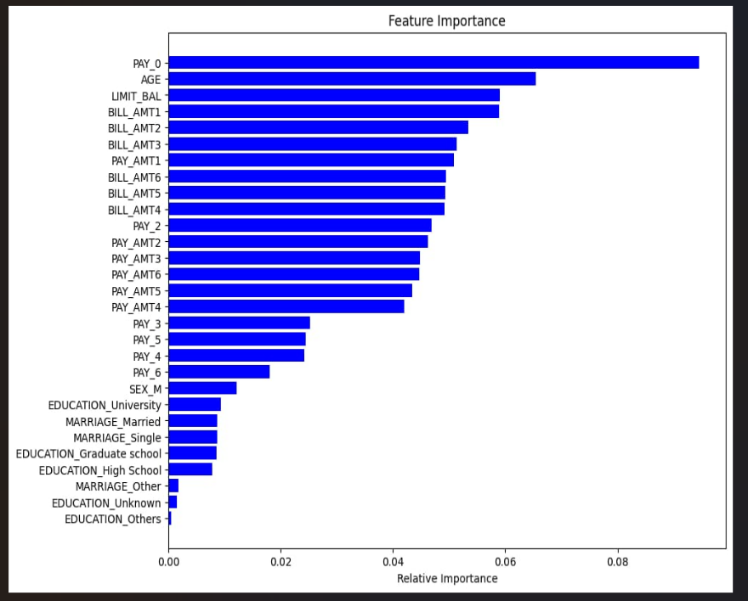
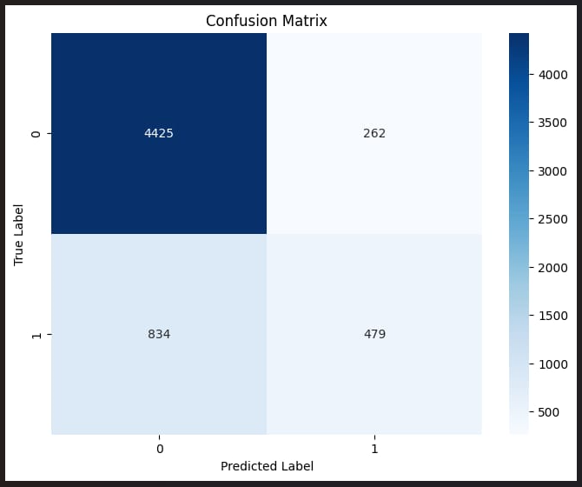
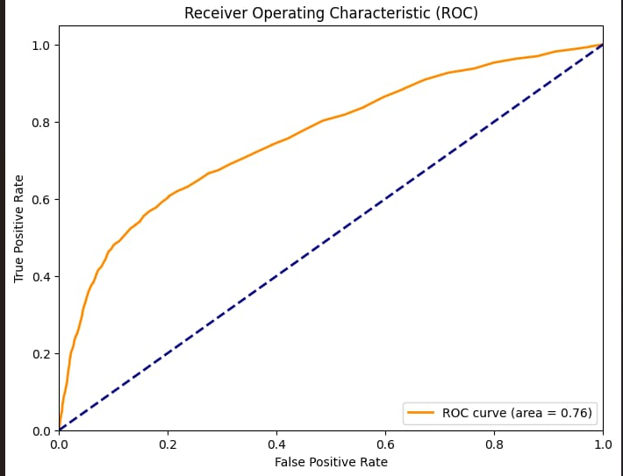
RESULT

Slide 11
CONCLUSION
This method involves several key steps, including data collection, preprocessing, feature engineering, model training, evaluation, and deployment.
Through meticulous data preprocessing and feature engineering, the algorithm transforms raw credit card payment data into meaningful features, ensuring optimal model performance. Logistic regression serves as a suitable modeling technique due to its interpretability and efficiency, making it well-suited for credit risk management applications.
Evaluation of the model's performance is conducted using various metrics, including accuracy, precision, recall, F1-score, ROC-AUC, and the K-S statistic. These metrics provide insights into the model's ability to distinguish between default and non-default cases accurately.
Deployment of the predictive model involves serialization, web application development, API deployment, containerization, cloud deployment, user interface design, security implementation, and continuous integration/continuous deployment (CI/CD). This comprehensive deployment process ensures that the model is accessible, scalable, secure, and continuously updated to meet evolving business needs.
Overall, the proposed approach offers a systematic and effective solution for predicting default payments in Taiwan, enabling organizations to mitigate credit risk, optimize decision-making, and enhance financial stability. By integrating this predictive model into their credit risk management systems, businesses can proactively identify and manage potential default risks, leading to improved operational efficiency and financial performance.

Slide 12
REFERENCES
https://www.kaggle.com/datasets
https://skills.yourlearning.ibm.com/activity/PLAN-D0B733510535
https://youtube.com/playlist?list=PLy3lFw0OTlutzXFVwttrtaRGEEyLEdnpy&si=fAkzJPfvwbT0xEnw
https://www.youtube.com/watch?v=GsfT2sv_zCo
https://www.youtube.com/watch?v=ABu8o3d1998&t=12s
https://www.youtube.com/watch?v=ABu8o3d1998&t=2s
https://www.youtube.com/watch?v=WIbq5CsAPRA&t=1s

Slide 13
THANK YOU

